Slide 1
RT-1 (robot transformer)

Slide 2
content
1. task
2. dataset
3. Preliminaries
4. model architecture

Slide 3
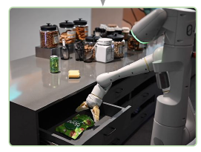
Task define
building and demonstrating a general robot learning system that can absorb large amounts of data and generalize effectively by using Transformer architecture
7 DOF (x, y, z, roll, pitch, yaw, grip)
three of environment (kitchens)

Slide 4
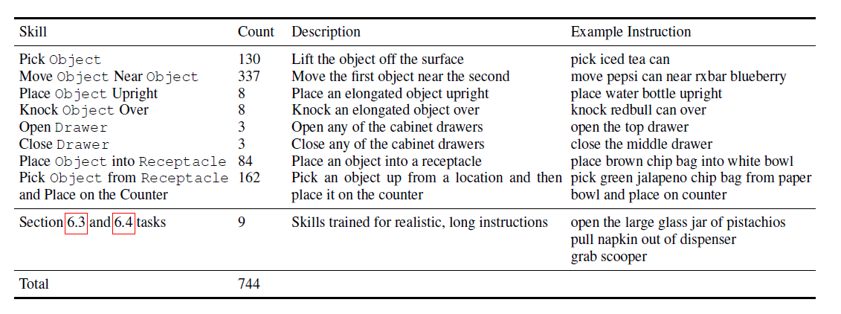
Dataset composition
Some simple instructions
Two type of split pivot ( skill, object )
Ex) pick up coke can, throw apple

Slide 5
Preliminaries
aim to learn robot policies to solve language-conditioned tasks from vision.
RT-1 uses a Transformer to parameterize the policy π.
dataset D = {(i(n), {(x(n)_t , a(n)_t )}T(n)_t=0 )}N_n=0 of episodes

Slide 6
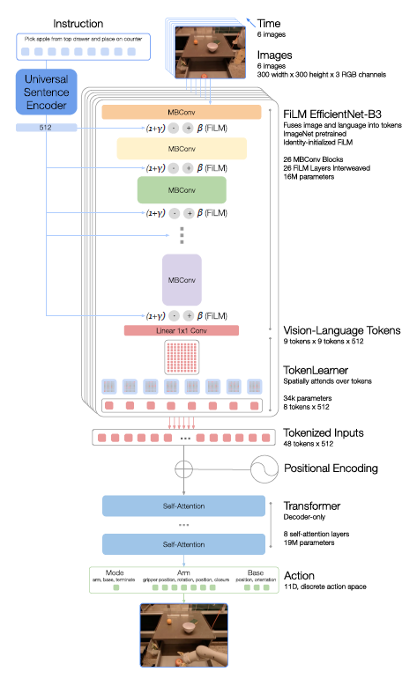
Model

Slide 7
Instruction and image tokenization
Input : 6 image (300 x 300), instruction
Image → EfficientNetB3 → feature map (9 x 9 x 512)
Instruction → Sentence Encoder → FiLM

Slide 8
TokenLearner
Large number of tokens → smaller number of tokens
81 (9 x 9) tokens → 8 tokens
6 image per 8 tokens → total 48 tokens

Slide 9
Transformer
decoder-only sequence model with 8 self-attention layers

Slide 10
Action tokenization
Total 11 variables
1 : mode (controlling arm, base
or terminating the episode )
7 : arm movement ( x, y, z, roll, pitch, yaw, grib)
3 : base movement ( x, y, yaw )
All of variables are represented by 256 bins

Slide 11
Appendix
Loss function : CE
Inference speed : consistently speed ( control frequency 3Hz, latency 100ms )
Good performance about incorporating simulation data
It can absorb data from different robots.

